Slide 1
Threads and Processes
Lecture 8

Slide 2
What is a thread?
A thread is a sequence of instructions that can be executed in parallel with other threads
Threads of a program are not full-blown processes, but are smaller portions of the process running concurrently (or in parallel). Hence, the term lightweight is used

Slide 3
Needles and Threads
A thread is a fibre used in sewing with a needle
Think of this
Think of sewing needles as the CPUs and the threads in a program as the fibre. If you had two needles but only one thread, it would take longer to finish the job than if you split the thread into two and used both needles at the same time.
Taking this analogy a little further, if one needle had to sew on a button (blocking I/O), the other needle could continue doing other useful work even if the other needle took 4 hours to sew on a single button. If you only used one needle, you would be ~4 hours behind
We will see the term LWP or lightweight process being used

Slide 4
Threads and Processes
In traditional single-threaded process systems, a process has a set of properties. In multi-threaded systems, these properties are divided between processes and threads.

Slide 5
Single and Multi-threading
Single threading
  This is a process with only one thread of control so is essentially a single process or one processing one command at a time.
Multithreading
  Allows applications to manage a, separate, process with several threads of control; This allows the OS to emulate a system with multiple processors and a common memory.
  In reduces overheads associated with swapping the whole process in and out of memory.
  In other words different parts of the program can be run concurrently in a single processor system or in parallel in a multi-processor system.
Understanding Operating Systems

Slide 6
Examples of multithreading
Examples of multithreading:
  Multiple queries to a database (a separate thread for each query);
  Multiple connections TCP connections: a separate thread to deal with each connection.
  An application that has a processing element and an i/o element where one thread processing and one thread to deal with the I/O
  A word processor will have many threads; one for inputting data, one for backup or archiving the word document…
Understanding Operating Systems

Slide 7
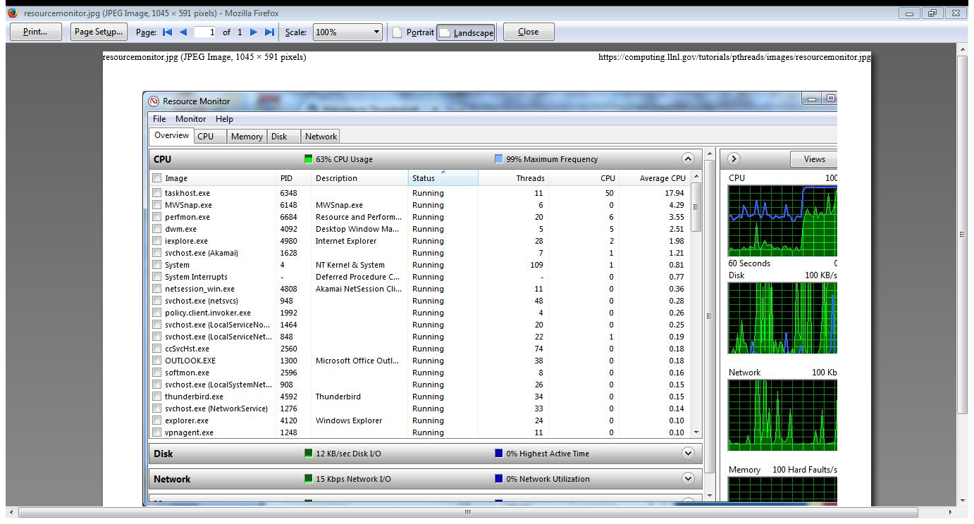
Thread utilisation in Windows
Understanding Operating Systems

Slide 8

Single and Multithreaded Processes
THREADS
4: Threads

Slide 9
Thread properties
A thread is the schedulable entity. It has only those properties that are required to ensure its independent flow of control. These include the following properties:
  Stack
  Scheduling properties (such as policy or priority)
  Set of pending and blocked signals
  Some thread-specific data.
Threads within a process must not be considered as a group of processes. All threads share the same address space. This means that two pointers having the same value in two threads refer to the same data. Also, if any thread changes one of the shared system resources, all threads within the process are affected; e.g. Closing files… shared address…

Slide 10
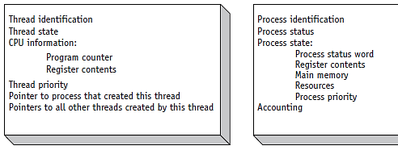
(figure 4.4)
Comparison of a typical Thread Control Block (TCB) vs. a Process Control Block (PCB).
© Cengage Learning 2014
Understanding Operating Systems, 7e

Slide 11
Thread Creation and Implementation
The Initial Thread
When a process is created, one thread is automatically created. This thread is called the initial thread. It ensures the compatibility between the old processes with a unique implicit thread and the new multi-threaded processes. The initial thread has some special properties, not visible to the programmer, that ensure binary compatibility between the old single-threaded programs and the multi-threaded operating system. It is also the initial thread that executes the main routine in multi-threaded programs.
Threads Implementation
A thread is the schedulable entity, which means that the system scheduler handles threads. These threads, known by the system scheduler, are strongly implementation-dependent. To facilitate the writing of portable programs, libraries provide another kind of thread.

Slide 12
Thread States
Operating systems must be able to:
  Create new threads
  Set up a thread so it is ready to execute
  Delay, or put to sleep, threads for a specified amount of time
  Block, or suspend, threads waiting for I/O to be completed
  Set threads to a WAIT state until a specific event occurs: until another thread finishes execution
  Schedule threads for execution
  Terminate a thread and release its resources
Understanding Operating Systems

Slide 13
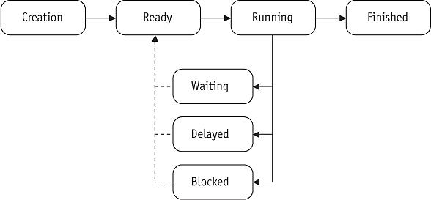
(figure 4.3)
A typical thread changes states from READY to FINISHED as it moves through the system.
© Cengage Learning 2014
Understanding Operating Systems

Slide 14
Thread States (cont’d.)
Thread transitions
  Application creates a thread: placed in READY queue
  READY to RUNNING: Process Scheduler assigns it to a processor
  RUNNING to WAITING: when dependent on an outside event, e.g., mouse click, or waiting for another thread to finish
  WAITING to READY: outside event occurs or previous thread finishes
Understanding Operating Systems

Slide 15
Thread States (cont’d.)
Thread transitions (cont’d.)
  RUNNING to DELAYED: application that delays thread processing by specified amount of time
  DELAYED to READY: prescribed time elapsed
  RUNNING to BLOCKED: I/O request issued
  BLOCKED to RUNNING: I/O completed
  RUNNING to FINISHED: exit or termination
    All resources released
Understanding Operating Systems

Slide 16
Programming Preliminaries
Include pthread.h in the main file
Compile program with –lpthread
  gcc –o test test.c –lpthread
  may not report compilation errors otherwise but calls will fail
Good idea to check return values on common functions

Slide 17
Creating Threads:
Initially, your main() program comprises a single, default thread. All other threads must be explicitly created by the programmer.
pthread_create creates a new thread and makes it executable. This routine can be called any number of times from anywhere within your code.

Slide 18
Thread creation
Types: pthread_t –data type ( thread)
Some calls:
  int pthread_create(pthread_t *thread,
  pthread_attr_t *attr,
  *start_routine,
  void *arg);
  void pthread_exit();
  No explicit parent/child model, except main thread holds process info
  Call pthread_exit in main, don’t just fall through;

Slide 19
pthread_create arguments:
  *thread: A unique identifier (pointer) for the new thread returned by the subroutine.
  attr: An attribute object that may be used to set thread attributes (joinable, detach, stack size…). You can specify a thread attributes object, or NULL for the default values. (more detail here thread_attributes)
  *start_routine: the C routine that the thread will execute once it is created.
  arg: A single argument that may be passed to start_routine. It must be passed by reference as a pointer cast of type void. NULL may be used if no argument is to be passed. Be aware that this single argument can also be an array of arguments (but this is still only a pointer

Slide 20
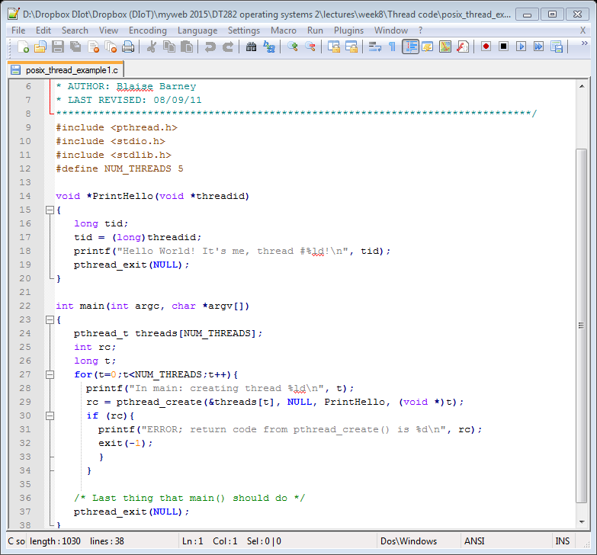
Create Thread example

Slide 21
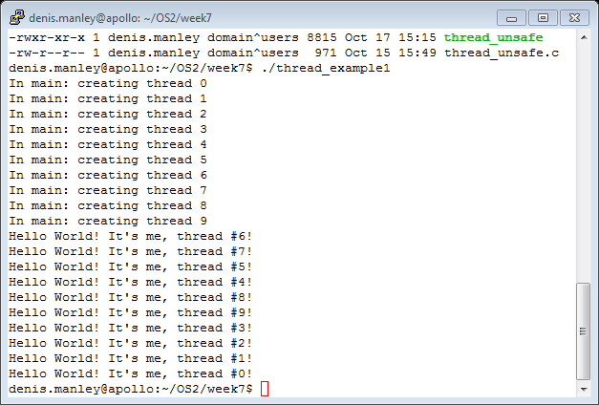
Thread example 1 with pass int

Slide 22
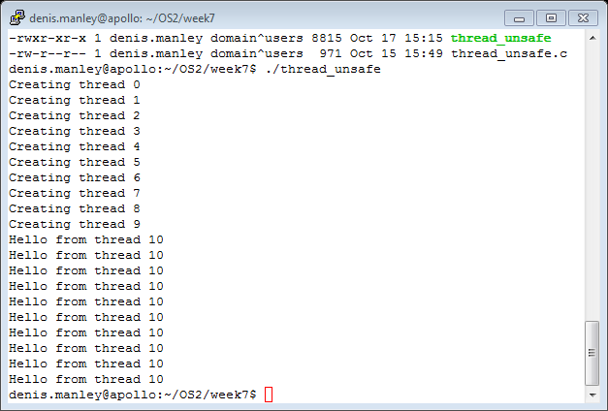
Thread_1 unsafe pass pointer &t and not t

Slide 23
A Warning of working with threads
For example, if a thread closes a file, the file is closed for all threads
If the arg passed in the create function does not take into account the data is shared between threads it may result in unforessen errors:
  see thread_unsafe.c
  In this example the variable t is passed by reference and its is data common to each thread so the “by reference” can change its value so it could lead to problems.
  rc = pthread_create(&threads[t], NULL, PrintHello, (void *) &t);
  The &t should be t as t is a shared variable

Slide 24
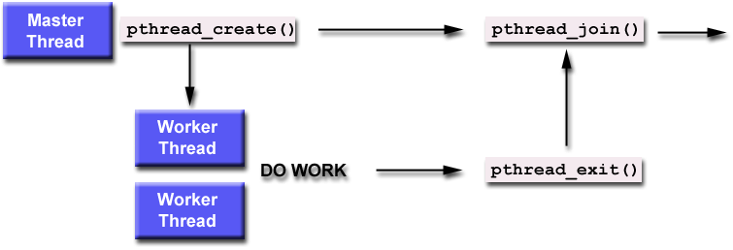
Illustration of thread join

Slide 25
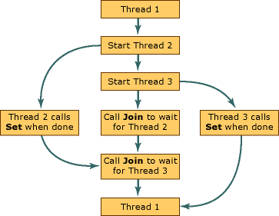
Thread join (with two threads)

Slide 26
Thread Joining
Joining is similar to wait()
"Joining" is one way to accomplish synchronization between threads.
The pthread_join() subroutine blocks the calling thread until the specified threadid thread terminates.
On success, pthread_join() returns 0; on error, it returns an error number.
The thread specified by thread must be joinable.
This is a way to ensure that the process itself does not terminate before the threads and so destroy (not execute) the threads

Slide 27
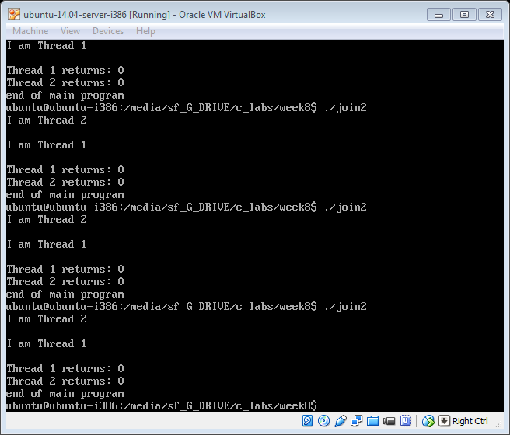
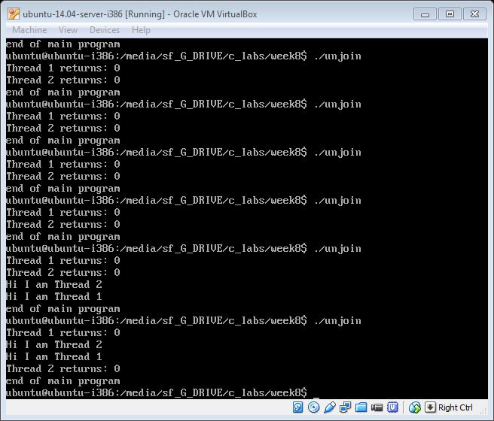
Run the following to programs to see the effect of the pthread_join() function
ThreadJoin.c and ThreadUnjoin.c. sample output

Slide 28
/* create the thread */
retcode = pthread_create(&tid,NULL,my_thread,argv[1]);
if (retcode != 0) {
fprintf (stderr, "Unable to create thread\n");
exit (1);
}
pthread_join(tid,NULL);
printf ("I am the parent: Square = %d\n", value);
} //main
void *my_thread(void *param)
{
int i = atoi (param);
printf ("I am the child, passed value %d\n", i);
value = i * i;
pthread_exit(0);
}
Treads and command line arguments
#include<pthread.h>
#include <stdio.h>
#include<stdlib.h>
/* Example program creating thread to compute square of value */
int value;/* thread stores result here */
void *my_thread(void *param); /* the thread */
main (int argc, char *argv[])
{
pthread_t tid; /* thread identifier */
int retcode;
if (argc != 2) {
fprintf (stderr, "usage: a.out <integer value>\n");
exit(0);
}

Slide 29
Joinable or Not?
When a thread is created, one of its attributes defines whether it is joinable or detached. Only threads that are created as joinable can be joined. If a thread is created as detached, it can never be joined.
The final draft of the POSIX standard specifies that threads should be created as joinable. It is by default.

Slide 30
To explicitly create a thread as joinable or detached,
The attr argument in the pthread_create() routine is used. The typical 4 step process is:
  Declare a pthread attribute variable of the pthread_attr_t data type
  Initialize the attribute variable with pthread_attr_init()
  Set the attribute detached status with pthread_attr_setdetachstate()
  When done, free library resources used by the attribute with pthread_attr_destroy()

Slide 31
Make it Explicitly Joinable
If a thread requires joining, consider explicitly creating it as joinable. This provides portability as not all implementations may create threads as joinable by default.
If you know in advance that a thread will never need to join with another thread, consider creating it in a detached state. Some system resources may be able to be freed. To set as detachable use: PTHREAD_CREATE_DETACHED instead of PTHREAD_CREATE_JOINABLE
Refer to thread_explicit_join.c

Slide 32
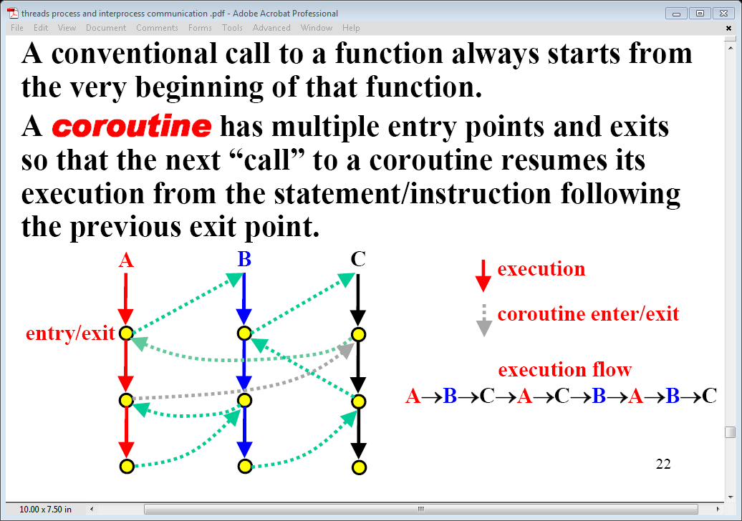
Flow of Thread execution

Slide 33
Other synchronisation methods
Two other synchronization methods, mutexes and condition variables, will be discussed later.
Shared memory is another type of synchronisation used to prevent the RACE problem.

Slide 34
Some Performance Considerations
The performance gains from using threads is great, but can it be even better? You should consider the following when analyzing your program for potential bottlenecks:
Lock granularity - How "big" (coarse) or "small" (fine) are your mutex locks? Do they lock your whole structure or fields of a structure? The more fine-grained you make your locks, the more concurrency you can gain, but at the cost of more overhead and potential deadlocks.
Lock ordering - Make sure your locks are always locked in an agreed order (if they are not, make sure you take steps to rectify situations where locks are obtained in an out-of-order fashion, e.g. by using trylock/unlock calls).
Lock frequency - Are you locking too often? Locking at unnecessary
times? Reduce such occurences to fully exploit concurrency and reduce synchronization overhead.
Critical sections - This has been mentioned before (twice), but you should take extra steps to minimize critical sections which can be potentially large bottlenecks.

Slide 35
Sample question
What is a thread control block (4 marks).
Distinguish between a single and a multi-threading system. (4 marks)
Give two examples of multi-threading (4 marks)
What are the main states that a thread can undergo (8 marks)

Slide 36
Sample Questions
To create a thread in posix C programming a number of parameter are required. Explain in your own words what each of the following parameters of the thread function mean:
int pthread_create(pthread_t *tidp, const pthread_attr_t *attr, *start_rtn, void *restrict arg) (8 marks)

Slide 37
Sample Question
Explain the code for the threadjoin.c program (you will be given the code without comments) (8 marks)
Explain, using sample output, what will happen if the two “thread_join” statements were removed (6 marks)
You will be given the above code in the exam. (you are not expected to remember and write these programs)

Slide 38
Reference material
Kernal threads: The programmer has no direct control over these threads, unless writing kernel extensions or device drivers. See AIX Version 4.3 Kernel Extensions and Device Support Programming Concepts for more information about kernel programming.
Posix threads:

